Slide 1
BDAT1000 Final Presentation
Rohith Kumar Anil (200504198)

Slide 2
Introduction To Dataset

Slide 3
Superstore Dataset
A dataset containing order details and order return details of various products in a superstore .
Data from the years 2015-2018.
An excel file containing two workbooks – Orders & Returns.

Slide 4
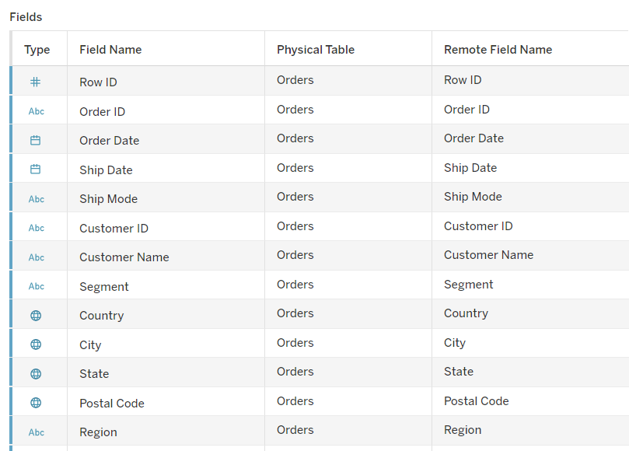
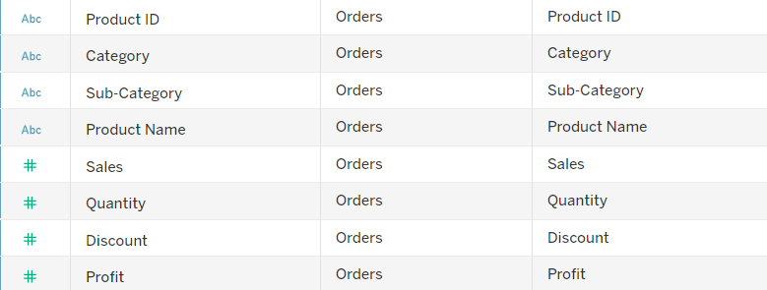
Orders

Slide 5
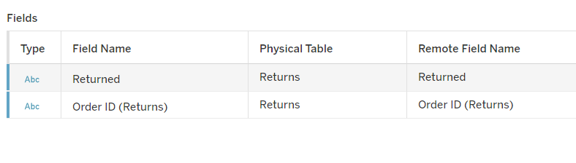
Returns

Slide 6
Why this dataset?
Simple to analyse
Almost 10,000 rows of data
This type of datasets are really good for visualising and finding patterns

Slide 7
Which time period saw the greatest sales?

Slide 8
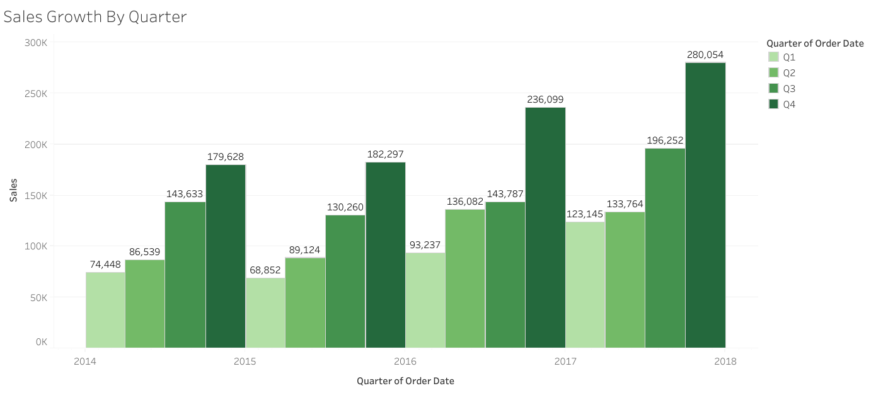

Slide 9
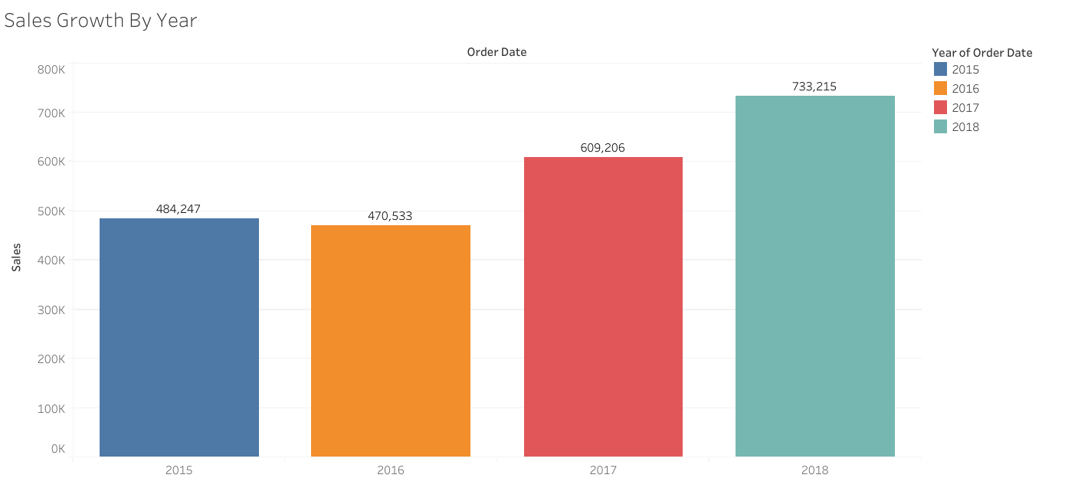

Slide 10
What are the no. of returns each year and is there any relation between shipping mode and no. of returns?

Slide 11
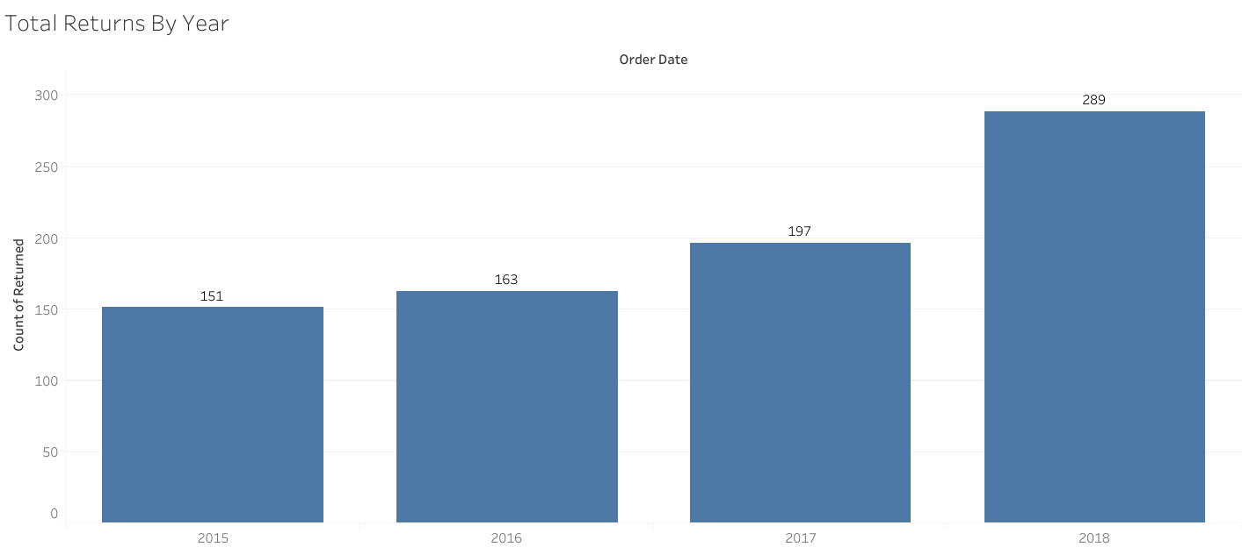

Slide 12
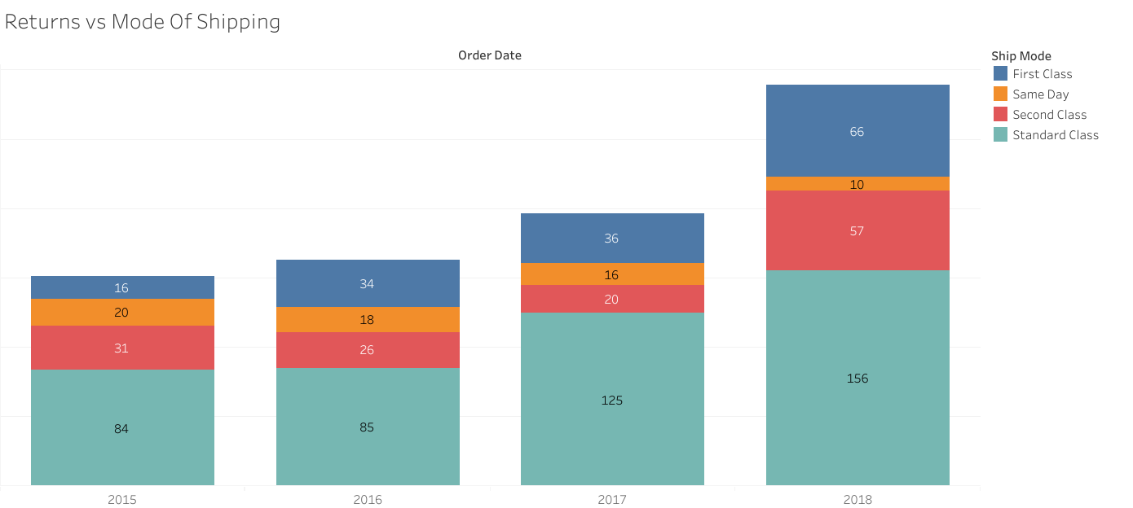

Slide 13
Which state has the highest sales?

Slide 14
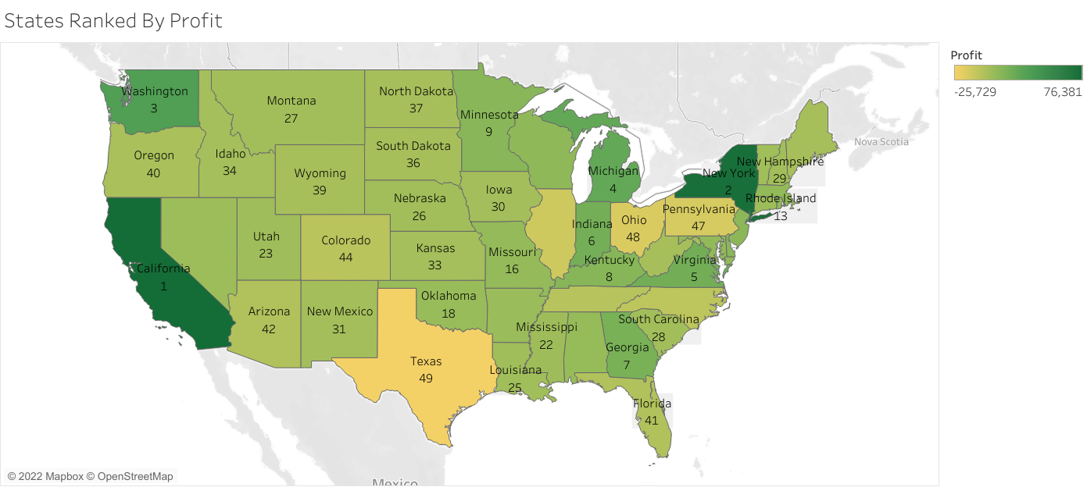

Slide 15
What are the total no. of unique customers in each year?

Slide 16
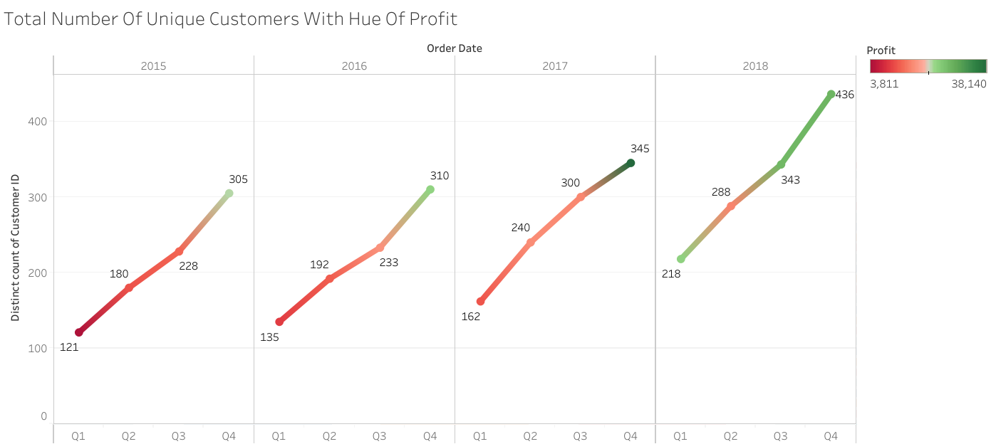

Slide 17
Which are the most popular categories?

Slide 18
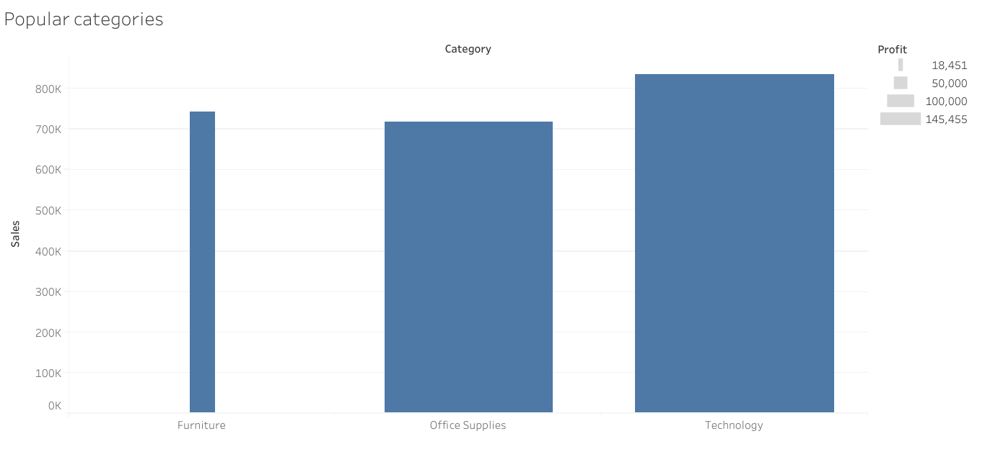

Slide 19
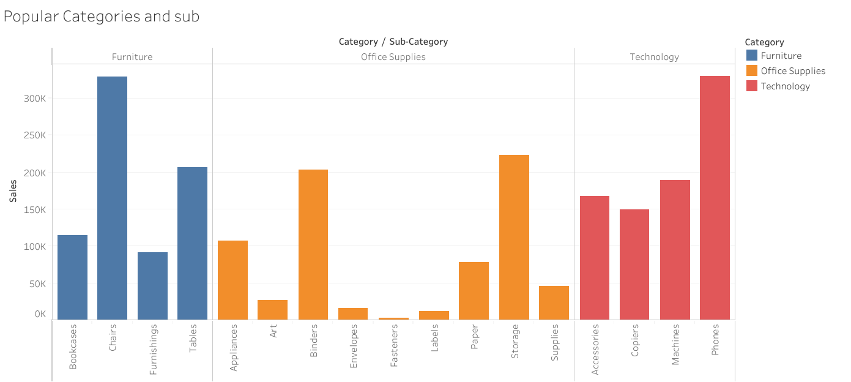

Slide 20
End

Slide 21
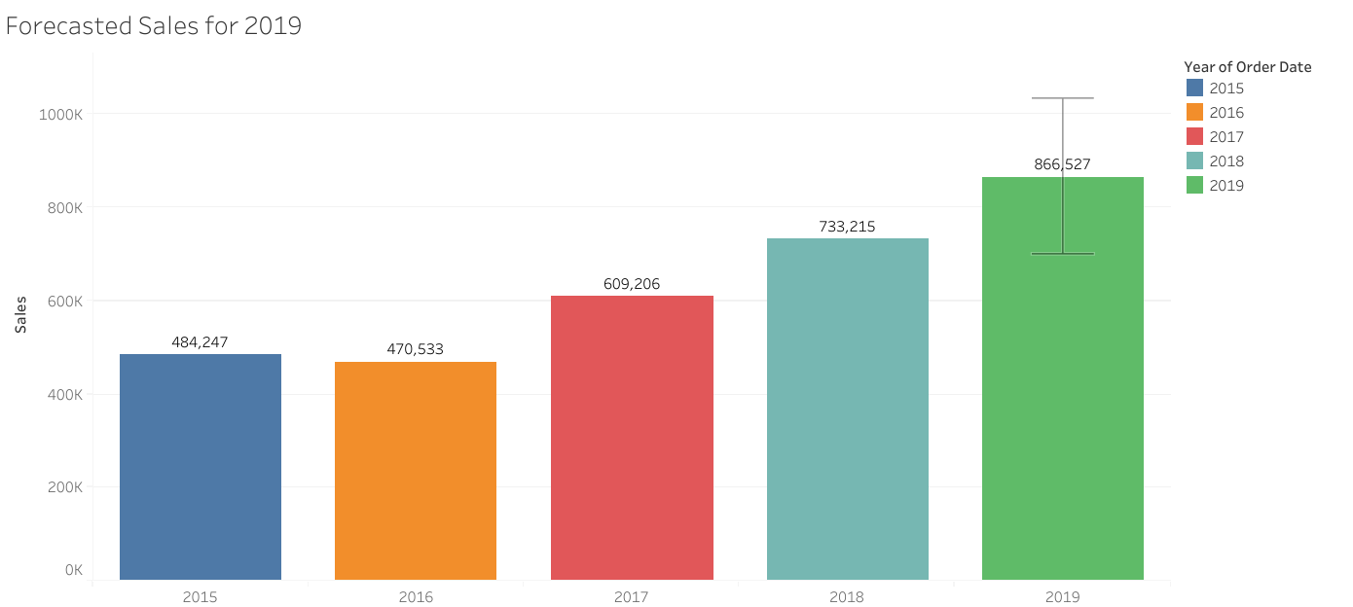

Slide 22
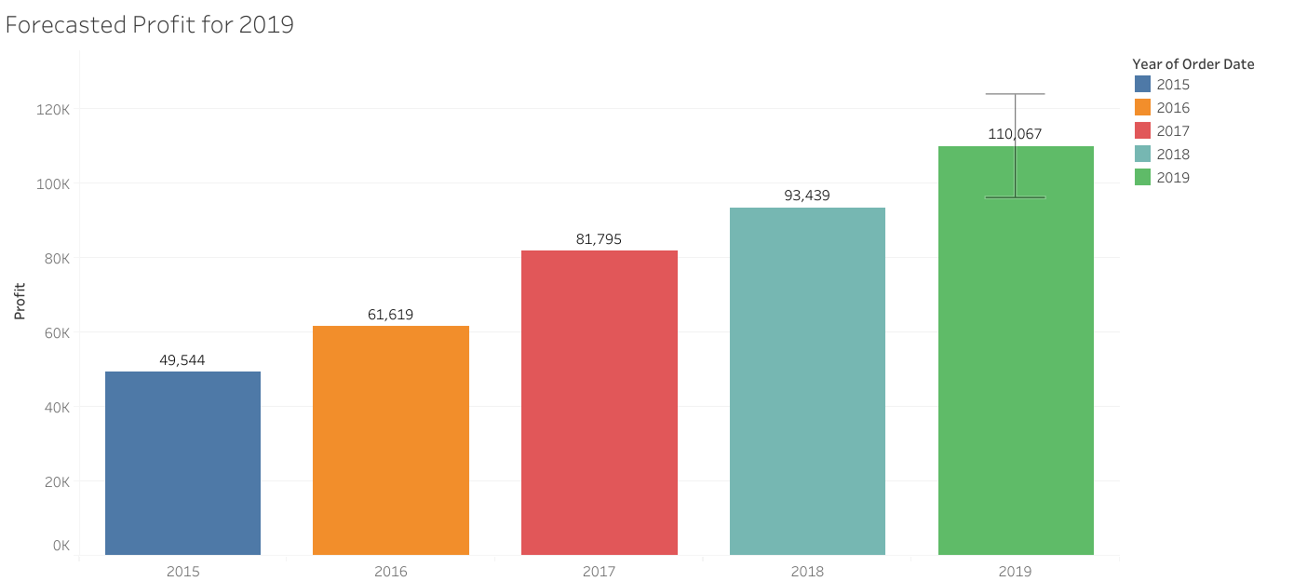

Slide 23
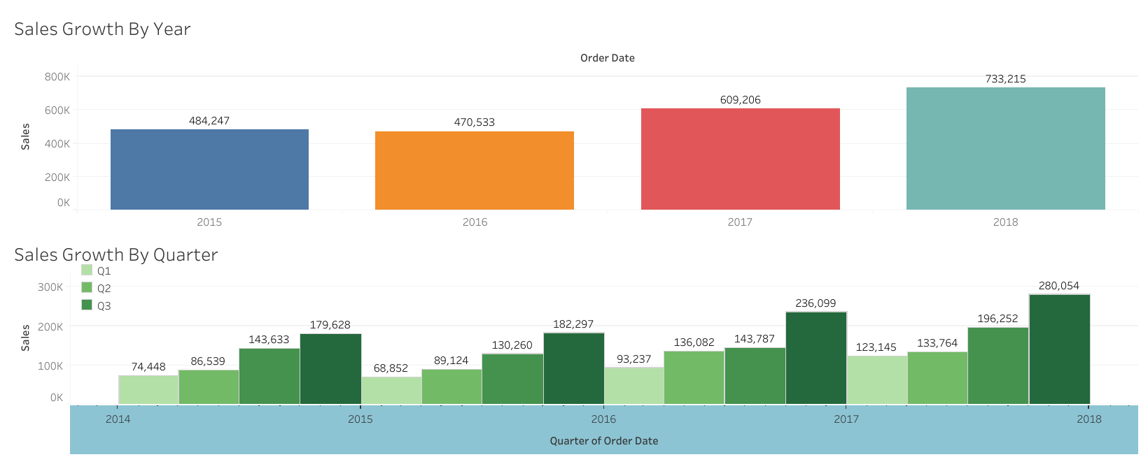

Slide 24
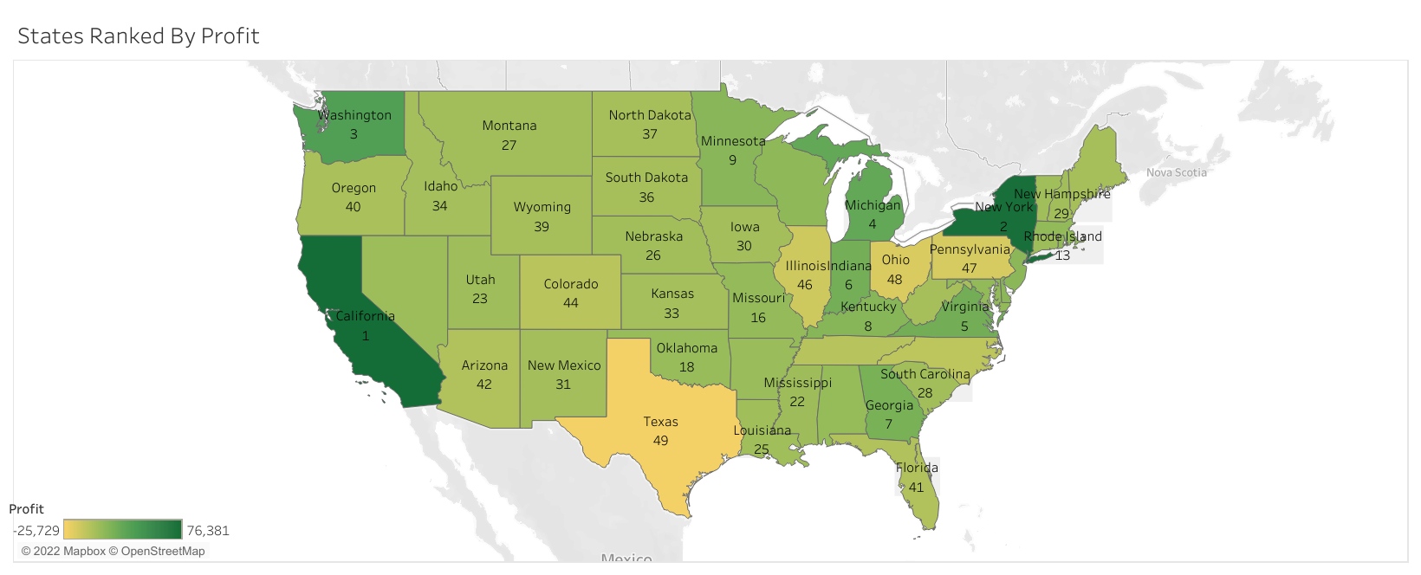

Slide 25
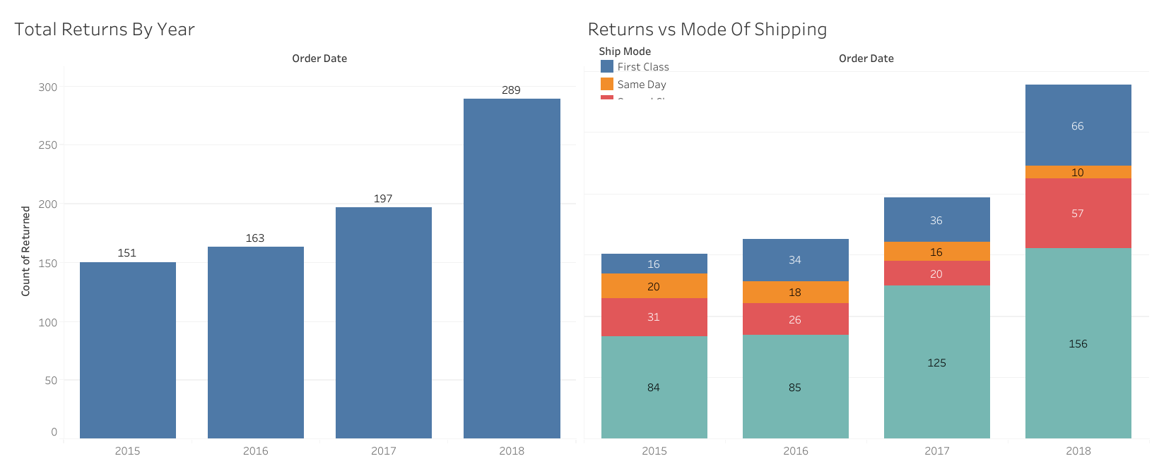

Slide 26
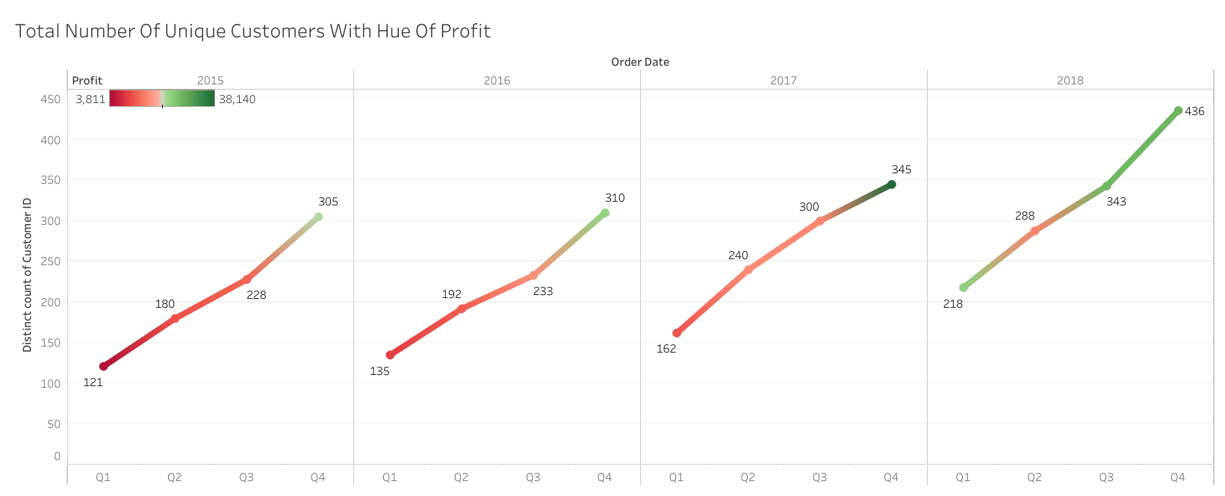

Slide 27
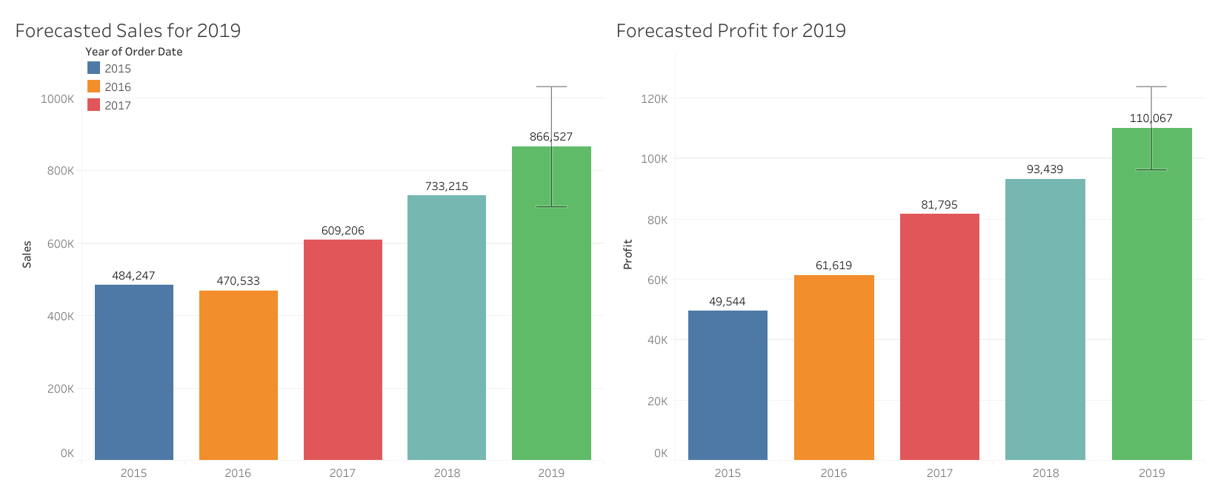

Slide 28
